Slide 1
What is a Protocol?
A standard that allows entities (i.e. application programs) from different systems to communicate
Shared conventions for communicating information
Includes syntax, semantics, and timing

Slide 2
Standardized Protocol Architectures
Vendors like standards because they make their products more marketable
Customers like standards because they enable products from different vendors to interoperate
Two protocol standards are well-known:
TCP/IP: widely implemented
OSI: less used, still useful for modeling/conceptualizing

Slide 3
Internet Standards
Email related standards
IMAP, POP, X.400, SMTP, CMC, MIME, binhex, uuencode
Web related standards
http, CGI, html/xml/vrml/sgml
Internet directory standards
X.500, LDAP
Application standards
http, FTP, telnet, gopher, wais
Videoconferencing standards
H.320, H.323, Mpeg-1, Mpeg-2

Slide 4
*Telecommunication Standards Organizations
International Telecommunications Union - Telecommunication Standardization Sector (ITU-TSS). Formerly called the Consultative Committee on International Telegraph and Telephone (CCITT)
International Organization for Standards (ISO). Member of the ITU, makes technical recommendations about data communications interfaces.
American National Standards Institute (ANSI)
Institute of Electrical and Electronics Engineers (IEEE)
Internet Engineering Task Force (IETF)
Electronic Industries Association (EIA)
National Institute of Standards and Technology (NIST)
National Exchange Carriers Association (NECA)
Corporation for Open Systems (COS)
Electronic Data Interchange -(EDI) of Electronic Data Interchange for Administration Commerce and Transport (EDIFACT).

Slide 5
Protocol Data Units (PDU)
User data is passed from layer to layer
Control information is added/removed to/from user data at each layer
Header (and sometimes trailer)
each layer has a different header/trailer
Data + header + trailer = PDU (Protocol Data Unit)
This is basically what we call packet
each layer has a different PDU

Slide 6
Standard Protocol Architectures
Two approaches (standard)
OSI Reference model
never used widely
but well known
TCP/IP protocol suite
Most widely used
Another approach (proprietary)
IBM’s Systems Network Architecture (SNA)

Slide 7
OSI Reference Model
Open Systems Interconnection
Reference model
provides a general framework for standardization
defines a set of layers and services provided by each layer
one or more protocols can be developed for each layer
Developed by the International Organization for Standardization (ISO)
also published by ITU-T (International Telecommunications Union)

Slide 8
OSI Reference Model
A layered model
Seven layers – seven has been presented as the optimal number of layer
Delivered too late (published in 1984)!
by that time TCP/IP started to become the de facto standard
Although no OSI-based protocol survived, the model is still valid (in the textbooks)

Slide 9
OSI - The Layer Model
Each layer performs a subset of the required communication functions
Each layer relies on the next lower layer to perform more primitive functions
Each layer provides services to the next higher layer
Changes in one layer should not require changes in other layers

Slide 10
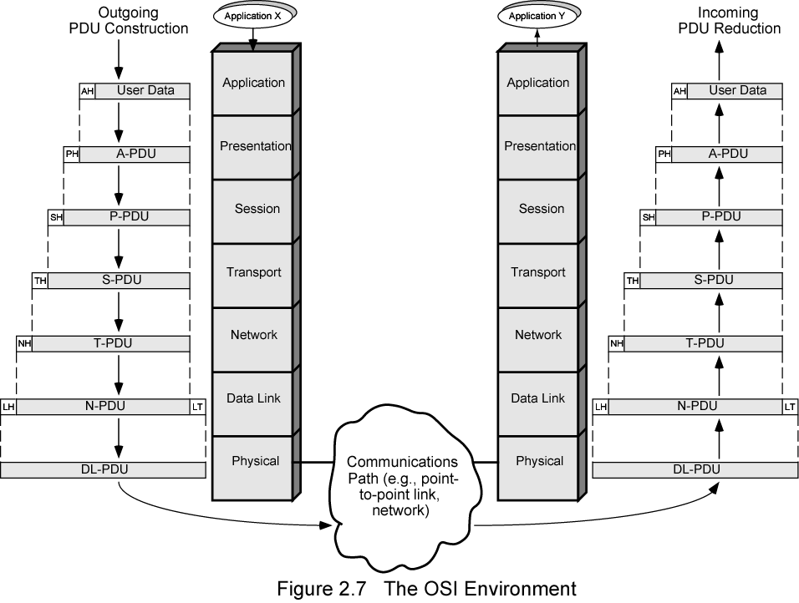
The OSI Environment

Slide 11
OSI Layers (1)
Physical
Physical interface between devices
Characteristics
Mechanical - interface specs
Electrical - voltage levels for bits, transmission rate, coding, etc.
Data Link
Basic services: error detection and control, flow control at the link level (point to point)
Higher layers may assume error free transmission
Later a sublayer is added to Data Link Layer
MAC (Medium Access Control) sublayer
to deal with broadcast networks

Slide 12
OSI Layers (2)
Network
Transfer of information through communication network
network related issues
Network nodes (relays/routers) should perform switching and routing functions
QoS (Quality of Service) and congestion control are also addressed in this layer
Several other internetworking issues
e.g. differences in addressing, max. data length, etc.
Higher layers do not need to know about underlying networking technology
Not needed on direct links

Slide 13
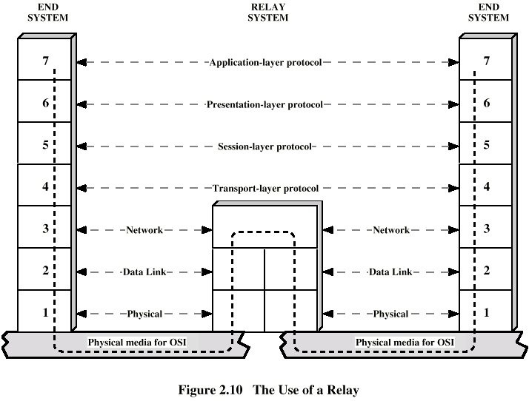
Use of a Relay/Router

Slide 14
OSI Layers (3)
Transport
End to end exchange of data
In sequence, no losses, no duplicates
If needed, upper layer data are split into smaller units
Session
Control of dialogues
whose turn to talk?
Dialogue discipline (full-duplex, half-duplex)
Checkpointing and recovery

Slide 15
OSI Layers (4)
Presentation
Data formats
Data compression
Encryption
Application
Support for various applications

Slide 16
OSI Lower Layers
Physical – Layer 1
Data Link – Layer 2
Network – Layer 3

Slide 17
OSI Physical Layer
Responsible for transmission of bits
Always implemented through hardware
Encompasses mechanical, electrical, and functional interfaces
e.g. RS-232

Slide 18
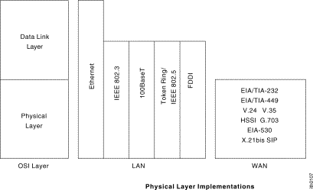
*Physical-layer Implementation

Slide 19
OSI Data Link Layer
Responsible for error-free, reliable transmission of data
Flow control, error correction
e.g. HDLC

Slide 20
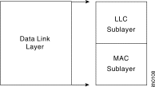
OSI Data Link Layer
IEEE has subdivided data link layer into two sub-layers.

Slide 21
OSI Network Layer
Responsible for routing of messages through network
Concerned with type of switching used (circuit v. packet)
Handles routing between networks, as well as through packet-switching networks

Slide 22
Network Access Layer
Concerned with exchange of data between computer and network
Includes addressing, routing, prioritizing, etc
Different networks require different software at this layer
Example: X.25 standard for network access procedures on packet-switching networks

Slide 23
OSI Upper Layers
Transport
Session
Presentation
Application

Slide 24
OSI Transport Layer
Isolates messages from lower and upper layers
Breaks down message size
Monitors quality of communications channel
Selects most efficient communication service necessary for a given transmission

Slide 25
Transport Layer
Concerned with reliable transfer of information between applications
Independent of the nature of the application
Includes aspects like flow control and error checking

Slide 26
OSI Session Layer
Establishes logical connections between systems
Manages log-ons, password exchange, log-offs
Terminates connection at end of session

Slide 27
OSI Presentation Layer
Provides format and code conversion services
Examples
File conversion from ASCII to EBDIC
Invoking character sequences to generate bold, italics, etc on a printer

Slide 28
OSI Application Layer
Provides access to network for end-user
User’s capabilities are determined by what items are available on this layer
Logic needed to support various applications
Each type of application (file transfer, remote access) requires different software on this layer

Slide 29
Application Viewpoint of a Network
Distributed data communications involves three primary components:
Networks
Computers
Applications
Three corresponding layers
Network access layer
Transport layer
Application layer

Slide 30
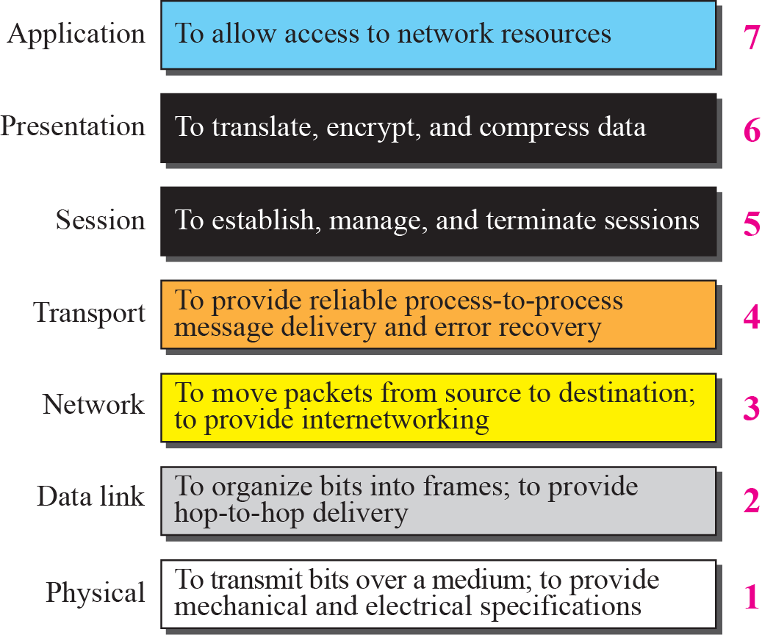
Figure 2.6 Summary of OSI Layers

Slide 31
2-3 TCP/IP PROTOCOL SUITE
The TCP/IP protocol suite was developed prior to the OSI model. Therefore, the layers in the TCP/IP protocol suite do not match exactly with those in the OSI model. The original TCP/IP protocol suite was defined as four software layers built upon the hardware. Today, however, TCP/IP is thought of as a five-layer model with the layers named similarly to the ones in the OSI model. Figure 2.7 shows both configurations.

Slide 32
Topics Discussed in the Section
Comparison between OSI and TCP/IP
Layers in the TCP/IP Suite

Slide 33
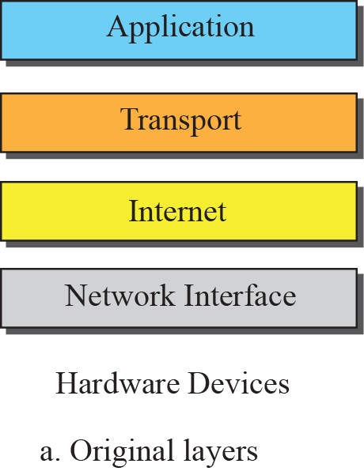
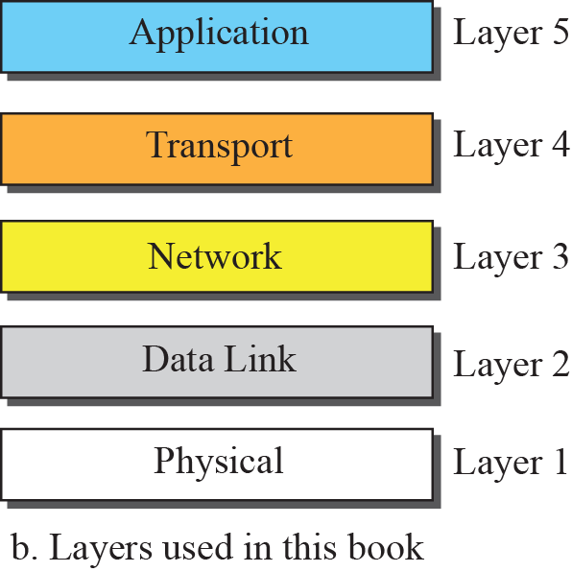
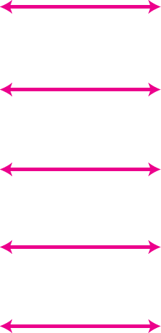
Figure 2.7 Layers in the TCP/IP Protocol Suite

Slide 34
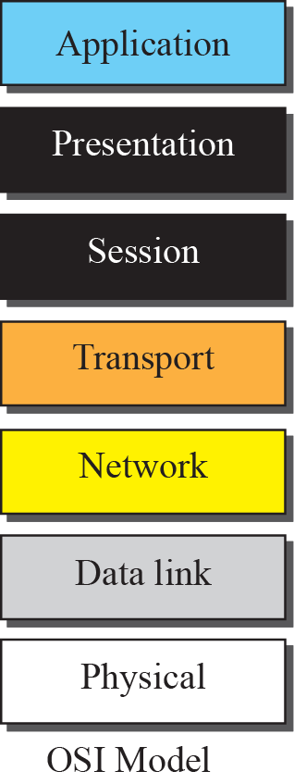
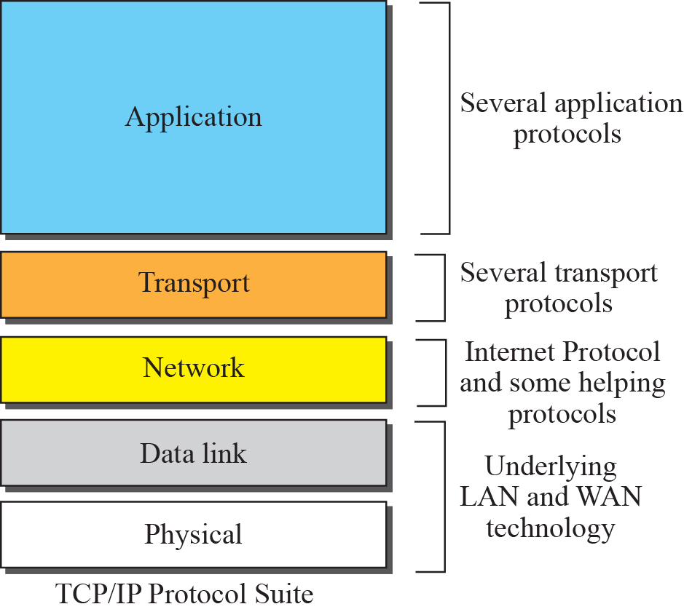
Figure 2.8 TCP/IP and OSI model

Slide 35
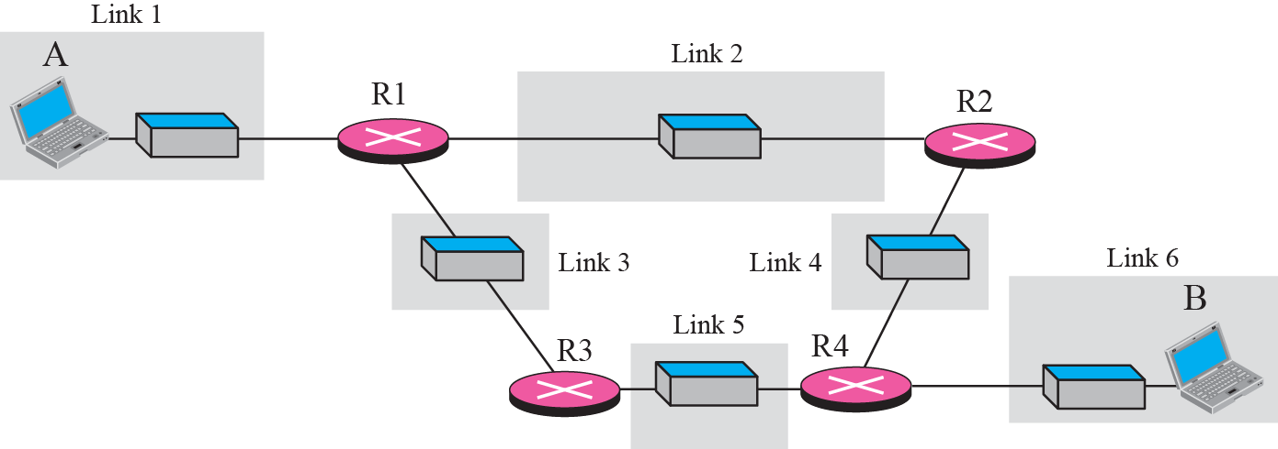
Figure 2.9 A private internet

Slide 36
Figure 2.10 Communication at the physical layer

Slide 37

Note
The unit of communication at the physical layer is a bit.

Slide 38
Figure 2.11 Communication at the data link layer

Slide 39
Note
The unit of communication at the data link layer is a frame.

Slide 40
Figure 2.12 Communication at the network layer

Slide 41
Note
The unit of communication at the network layer is a datagram.

Slide 42
Figure 2.13 Communication at transport layer

Slide 43
Note
The unit of communication at the transport layer is a segment, user datagram, or a packet, depending on the specific protocol used in this layer.

Slide 44
Figure 2.14 Communication at application layer

Slide 45
Note
The unit of communication at the application layer is a message.

Slide 46
2-4 ADDRESSING
Four levels of addresses are used in an internet employing the TCP/IP protocols: physical address, logical address, port address, and application-specific address. Each address is related to a one layer in the TCP/IP architecture, as shown in Figure 2.15.

Slide 47
Topics Discussed in the Section
Physical Addresses
Logical Addresses
Port Addresses
Application-Specific Addresses

Slide 48
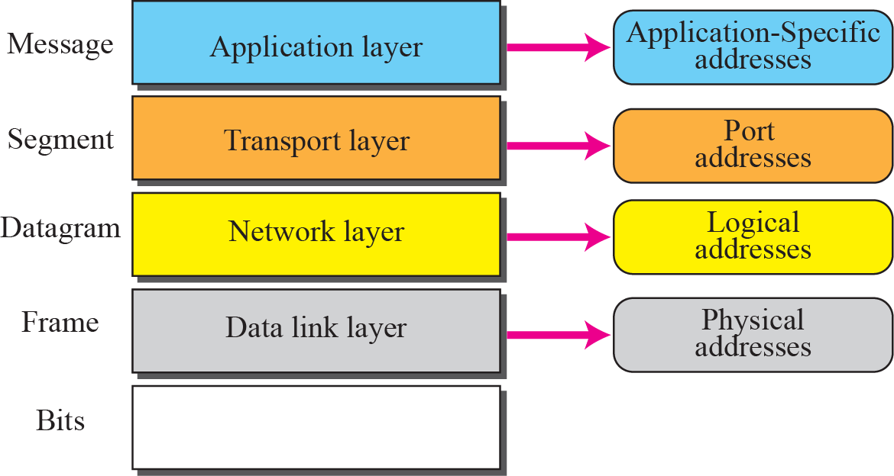
Figure 2.15 Addresses in the TCP/IP protocol suite

Slide 49
Example 2.3
In Figure 2.16 a node with physical address 10 sends a frame to a node with physical address 87. The two nodes are connected by a link (a LAN). At the data link layer, this frame contains physical (link) addresses in the header. These are the only addresses needed. The rest of the header contains other information needed at this level. As the figure shows, the computer with physical address 10 is the sender, and the computer with physical address 87 is the receiver. The data link layer at the sender receives data from an upper layer. It encapsulates the data in a frame. The frame is propagated through the LAN. Each station with a physical address other than 87 drops the frame because the destination address in the frame does not match its own physical address. The intended destination computer, however, finds a match between the destination address in the frame and its own physical address.

Slide 50
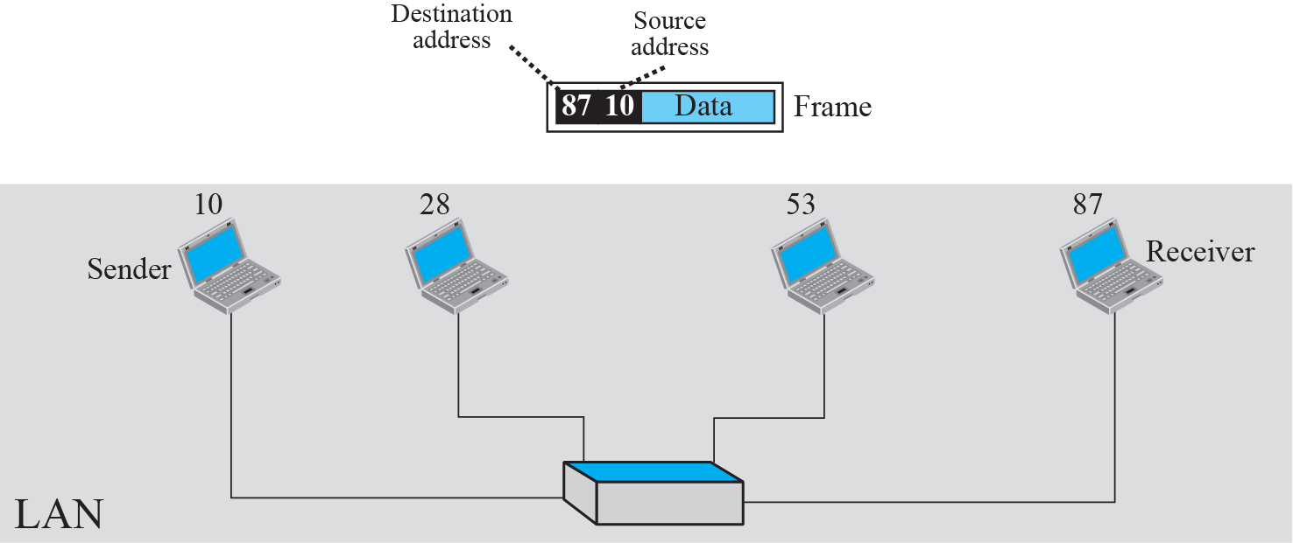
Figure 2.16 Example 2.3: physical addresses

Slide 51
Example 2.4
As we will see in Chapter 3, most local area networks use a 48-bit (6-byte) physical address written as 12 hexadecimal digits; every byte (2 hexadecimal digits) is separated by a colon, as shown below:
07:01:02:01:2C:4B
A 6-byte (12 hexadecimal digits) physical address

Slide 52
Example 2.5
Figure 2.17 shows a part of an internet with two routers connecting three LANs. Each device (computer or router) has a pair of addresses (logical and physical) for each connection. In this case, each computer is connected to only one link and therefore has only one pair of addresses. Each router, however, is connected to three networks. So each router has three pairs of addresses, one for each connection. Although it may be obvious that each router must have a separate physical address for each connection, it may not be obvious why it needs a logical address for each connection. We discuss these issues in Chapters 11 and 12 when we discuss routing. The computer with logical address A and physical address 10 needs to send a packet to the computer with logical address P and physical address 95. We use letters to show the logical addresses and numbers for physical addresses, but note that both are actually numbers, as we will see in later chapters.

Slide 53
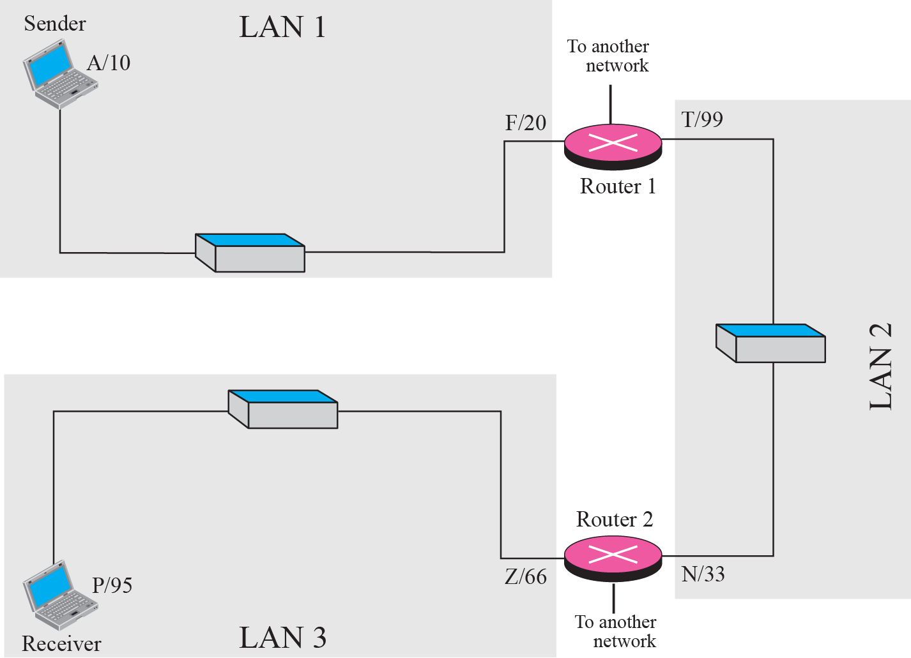
Figure 2.17 Example 2.5: logical addresses

Slide 54
Note
The physical addresses will change from hop to hop, but the logical addresses remain the same.

Slide 55
Example 2.6
Figure 2.18 shows two computers communicating via the Internet. The sending computer is running three processes at this time with port addresses a, b, and c. The receiving computer is running two processes at this time with port addresses j and k. Process a in the sending computer needs to communicate with process j in the receiving computer. Note that although both computers are using the same application, FTP, for example, the port addresses are different because one is a client program and the other is a server program, as we will see in Chapter 17.

Slide 56
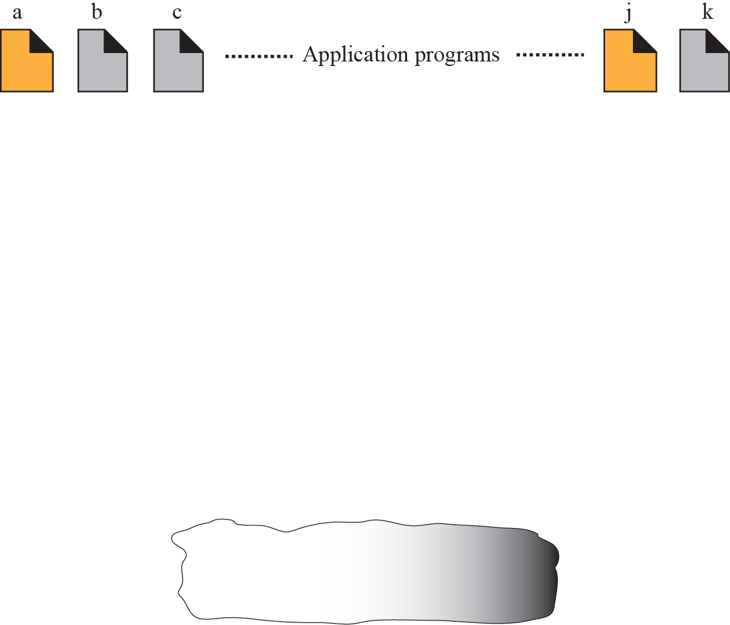
Figure 2.18 Example 2.6: port numbers

Slide 57
Note
The physical addresses change from hop to hop, but the logical and port addresses usually remain the same.

Slide 58
Example 2.7
As we will see in future chapters, a port address is a 16-bit address represented by one decimal number as shown.
753
A 16-bit port address represented as one single number

Slide 59
Ethernet
Data Link Layer protocol
Ethernet (IEEE 802.3) is widely used.
Supported by a variety of physical layer implementations.
Multi-access (shared medium).

Slide 60
CSMA/CD
Carrier Sense Multiple Access with Collision Detection
Carrier Sense : can tell when another host is transmitting
Multiple Access : many hosts on 1 wire
Collision Detection : can tell when another host transmits at the same time.

Slide 61
An Ethernet Frame
Preamble
Destination
Address
Source
Address
Len
DATA
CRC
8 bytes
6
6
2
0-1500
4
The preamble is a sequence of alternating 1s and 0s used for synchronization.
CRC is Cyclic Redundency Check

Slide 62
Ethernet Addressing
Every Ethernet interface has a unique 48 bit address (a.k.a. hardware address).
Example: C0:B3:44:17:21:17
The broadcast address is all 1’s.
Addresses are assigned to vendors by a central authority.
Each interface looks at every frame and inspects the destination address. If the address does not match the hardware address of the interface (or the broadcast address), the frame is discarded.

Slide 63
Internet Protocol
IP is the network layer
packet delivery service (host-to-host).
translation between different data-link protocols
IP provides connectionless, unreliable delivery of IP datagrams.
Connectionless: each datagram is independent of all others.
Unreliable: there is no guarantee that datagrams are delivered correctly or even delivered at all.

Slide 64
IP Addresses
IP addresses are not the same as the underlying data-link (MAC) addresses.
IP is a network layer - it must be capable of providing communication between hosts on different kinds of networks (different data-link implementations).
The address must include information about what network the receiving host is on. This is what makes routing feasible.
Why ?

Slide 65
IP Addresses
IP addresses are logical addresses (not physical)
32 bits.
Includes a network ID and a host ID.
Every host must have a unique IP address.
IP addresses are assigned by a central authority (American Registry for Internet Numbers for North America).
IPv4 (version 4)

Slide 66
The four formats of IP Addresses
Class
A
0
NetID
HostID
128 possible network IDs, over 4 million host IDs per network ID
B
10
NetID
HostID
16K possible network IDs, 64K host IDs per network ID
C
110
NetID
HostID
Over 2 million possible network IDs, 256 host IDs per network ID
D
1110
Multicast Address
8 bits
8 bits
8 bits
8 bits

Slide 67
Network and Host IDs
A Network ID is assigned to an organization by a global authority.
Host IDs are assigned locally by a system administrator.
Both the Network ID and the Host ID are used for routing.

Slide 68
IP Addresses
IP Addresses are usually shown in dotted decimal notation:
1.2.3.4
00000001 00000010 00000011 00000100
cse.unr.edu is 134.197.40.3
10000110 11000101 00101000 00000010
CSE has a class B network

Slide 69
Host and Network Addresses
A single network interface is assigned a single IP address called the host address.
A host may have multiple interfaces, and therefore multiple host addresses.
Hosts that share a network all have the same IP network address (the network ID).
An IP address that has a host ID of all 0s is called a network address and refers to an entire network.

Slide 70
Subnet Addresses
An organization can subdivide it’s host address space into groups called subnets.
The subnet ID is generally used to group hosts based on the physical network topology.
10
NetID
SubnetID
HostID

Slide 71
Subnetting
router
Subnet 1
134.197.1.x
Subnet 2
134.197.2.x
Subnet 3
134.197.3.x

Slide 72
Subnetting
Subnets can simplify routing.
IP subnet broadcasts have a hostID of all 1s.
It is possible to have a single wire network with multiple subnets.

Slide 73
Mapping IP Addresses to Hardware Addresses
IP Addresses are not recognized by hardware.
If we know the IP address of a host, how do we find out the hardware address ?
The process of finding the hardware address of a host given the IP address is called
Address Resolution

Slide 74
ARP
Arp Arp!
The Address Resolution Protocol is used by a sending host when it knows the IP address of the destination but needs the Ethernet (or whatever) address.
ARP is a broadcast protocol - every host on the network receives the request.
Each host checks the request against it’s IP address - the right one responds.
hosts remember the hardware addresses of each other.

Slide 75
ARP conversation
HEY - Everyone please listen!
Will 128.213.1.5 please send me his/her Ethernet address?
not me
Hi Green! I’m 128.213.1.5, and my Ethernet address is 87:A2:15:35:02:C3

Slide 76
IP Datagram
1 byte
1 byte
1 byte
1 byte
VERS
HL
Service
Fragment Length
Datagram ID
FLAG
Fragment Offset
TTL
Protocol
Header Checksum
Source Address
Destination Address
Options (if any)
Data

Slide 77
IP Datagram Fragmentation
Packets are fragmented due to link’s Maximum Transmission Unit (MTU)
Each fragment (packet) has the same structure as the IP datagram.
IP specifies that datagram reassembly is done only at the destination (not on a hop-by-hop basis).
If any of the fragments are lost - the entire datagram is discarded (and an ICMP message is sent to the sender).

Slide 78
IP Flow Control & Error Detection
If packets arrive too fast - the receiver discards excessive packets and sends an ICMP message to the sender (SOURCE QUENCH).
If an error is found (header checksum problem) the packet is discarded and an ICMP message is sent to the sender.

Slide 79
ICMP Internet Control Message Protocol
ICMP is a protocol used for exchanging control messages.
ICMP uses IP to deliver messages.
ICMP messages are usually generated and processed by the IP software, not the user process.

Slide 80
ICMP Message Types
Echo Request
Echo Response
Destination Unreachable
Redirect
Time Exceeded
Redirect (route change)
there are more ...

Slide 81
Transport Layer & TCP/IP
Q: We know that IP is the network layer - so TCP must be the transport layer, right ?
A: No… well, almost.
TCP is only part of the TCP/IP transport layer - the other part is UDP (User Datagram Protocol).

Slide 82
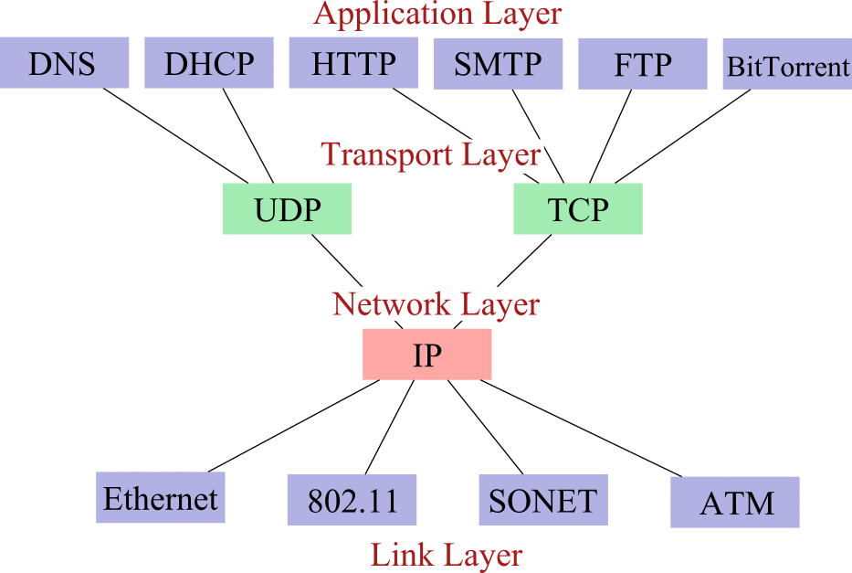
The Internet Hourglass
ICMP, ARP & RARP
802.3

Slide 83
UDP User Datagram Protocol
UDP is a transport protocol
communication between processes
UDP uses IP to deliver datagrams to the right host.
UDP uses ports to provide communication services to individual processes.

Slide 84
Ports
TCP/IP uses an abstract destination point called a protocol port.
Ports are identified by a positive integer.
Operating systems provide some mechanism that processes use to specify a port.
Host A
Host B
Process
Process
Process
Process
Process
Process

Slide 85
UDP
Datagram Delivery
Connectionless
Unreliable
Minimal
UDP Datagram Format
Source Port
Destination Port
Length
Checksum
Data

Slide 86
TCP Transmission Control Protocol
TCP is an alternative transport layer protocol supported by TCP/IP.
TCP provides:
Connection-oriented
Reliable
Full-duplex
Byte-Stream

Slide 87
Connection-Oriented
Connection oriented means that a virtual connection is established before any user data is transferred.
If the connection cannot be established, the user program is notified (finds out).
If the connection is ever interrupted, the user program(s) is finds out there is a problem.

Slide 88
Reliable
Reliable means that every transmission of data is acknowledged by the receiver.
Reliable does not mean that things don't go wrong, it means that we find out when things go wrong.
If the sender does not receive acknowledgement within a specified amount of time, the sender retransmits the data.

Slide 89
Byte Stream
Stream means that the connection is treated as a stream of bytes.
The user application does not need to package data in individual datagrams (as with UDP).

Slide 90
Buffering
TCP is responsible for buffering data and determining when it is time to send a datagram.
It is possible for an application to tell TCP to send the data it has buffered without waiting for a buffer to fill up.

Slide 91
Full Duplex
TCP provides transfer in both directions (over a single virtual connection).
To the application program these appear as 2 unrelated data streams, although TCP can piggyback control and data communication by providing control information (such as an ACK) along with user data.

Slide 92
TCP Ports
Interprocess communication via TCP is achieved with the use of ports (just like UDP).
UDP ports have no relation to TCP ports (different name spaces).

Slide 93
TCP Segments
The chunk of data that TCP asks IP to deliver is called a TCP segment.
Each segment contains:
data bytes from the byte stream
control information that identifies the data bytes

Slide 94
TCP Segment Format
1 byte
1 byte
1 byte
1 byte
Source Port
Destination Port
Sequence Number
Request Number
offset
Reser.
Control
Window
Checksum
Urgent Pointer
Options (if any)
Data

Slide 95
Addressing in TCP/IP
Each TCP/IP address includes:
Internet Address
Protocol (UDP or TCP)
Port Number
NOTE: TCP/IP is a protocol suite that includes IP, TCP and UDP

Slide 96
TCP vs. UDP
Q: Which protocol is better ?
A: It depends on the application.
TCP provides a connection-oriented, reliable, byte stream service (lots of overhead).
UDP offers minimal datagram delivery service (as little overhead as possible).

Slide 97
TCP Lingo
When a client requests a connection, it sends a “SYN” segment (a special TCP segment) to the server port.
SYN stands for synchronize. The SYN message includes the client’s ISN.
ISN is Initial Sequence Number.

Slide 98
More...
Every TCP segment includes a Sequence Number that refers to the first byte of data included in the segment.
Every TCP segment includes a Request Number (Acknowledgement Number) that indicates the byte number of the next data that is expected to be received.
All bytes up through this number have already been received.

Slide 99
And more...
There are a bunch of control flags:
URG: urgent data included.
ACK: this segment is (among other things) an acknowledgement.
RST: error - abort the session.
SYN: synchronize Sequence Numbers (setup)
FIN: polite connection termination.

Slide 100
And more...
MSS: Maximum segment size (A TCP option)
Window: Every ACK includes a Window field that tells the sender how many bytes it can send before the receiver will have to toss it away (due to fixed buffer size).

Slide 101
TCP Connection Creation
Programming details later - for now we are concerned with the actual communication.
A server accepts a connection.
Must be looking for new connections!
A client requests a connection.
Must know where the server is!

Slide 102
Client Starts
A client starts by sending a SYN segment with the following information:
Client’s ISN (generated pseudo-randomly)
Maximum Receive Window for client.
Optionally (but usually) MSS (largest datagram accepted).
No payload! (Only TCP headers)

Slide 103
Sever Response
When a waiting server sees a new connection request, the server sends back a SYN segment with:
Server’s ISN (generated pseudo-randomly)
Request Number is Client ISN+1
Maximum Receive Window for server.
Optionally (but usually) MSS
No payload! (Only TCP headers)

Slide 104
Finally
When the Server’s SYN is received, the client sends back an ACK with:
Request Number is Server’s ISN+1

Slide 105
Client
Server
SYN
ISN=X
1
SYN
ISN=Y ACK=X+1
time
2
ACK=Y+1
3

Slide 106
TCP Data and ACK
Once the connection is established, data can be sent.
Each data segment includes a sequence number identifying the first byte in the segment.
Each segment (data or empty) includes a request number indicating what data has been received.

Slide 107
TCP Buffers
The TCP layer doesn’t know when the application will ask for any received data.
TCP buffers incoming data so it’s ready when we ask for it.
Both the client and server allocate buffers to hold incoming and outgoing data
The TCP layer does this.
Both the client and server announce with every ACK how much buffer space remains (the Window field in a TCP segment).

Slide 108
Send Buffers
The application gives the TCP layer some data to send.
The data is put in a send buffer, where it stays until the data is ACK’d.
it has to stay, as it might need to be sent again!
The TCP layer won’t accept data from the application unless (or until) there is buffer space.

Slide 109
ACKs
A receiver doesn’t have to ACK every segment (it can ACK many segments with a single ACK segment).
Each ACK can also contain outgoing data (piggybacking).
If a sender doesn’t get an ACK after some time limit (MSL) it resends the data.

Slide 110
TCP Segment Order
Most TCP implementations will accept out-of-order segments (if there is room in the buffer).
Once the missing segments arrive, a single ACK can be sent for the whole thing.
Remember: IP delivers TCP segments, and IP in not reliable - IP datagrams can be lost or arrive out of order.

Slide 111
Termination
The TCP layer can send a RST segment that terminates a connection if something is wrong.
Usually the application tells TCP to terminate the connection politely with a FIN segment.

Slide 112
TCP/IP Protocol Suite
Most widely used interoperable network protocol architecture
Specified and extensively used before OSI
OSI was slow to take place in the market
Funded by the US Defense Advanced Research Project Agency (DARPA) for its packet switched network (ARPANET)
DoD automatically created an enormous market for TCP/IP
Used by the Internet and WWW

Slide 113
TCP/IP Protocol Suite
TCP/IP does not have an official layer structure
But protocols imply one
Application layer
Transport (host to host) layer
Internet layer
Network access layer
Physical layer
Actually TCP/IP reference model has been built on its protocols
That is why that reference model is only for TCP/IP protocol suite
and this is why it is not so important to assign roles to each layer in TCP/IP; understanding TCP, IP and the application protocols would be enough

Slide 114
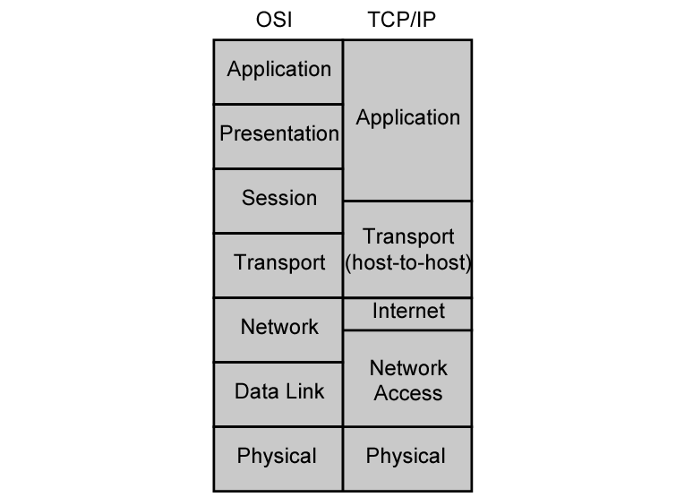
OSI vs. TCP/IP
HTTP, SMTP, …
TCP, UDP
IP

Slide 115
Network Access and Physical Layers
TCP/IP reference model does not discuss these layers too much
the node should connect to the network with a protocol such that it can send IP packets
this protocol is not defined by TCP/IP
mostly in hardware
a well known example is Ethernet

Slide 116
Internet Layer
Connectionless, point to point internetworking protocol (uses the datagram approach)
takes care of routing across multiple networks
each packet travels in the network independently of each other
they may not arrive (if there is a problem in the network)
they may arrive out of order
a design decision enforced by DoD to make the system more flexible and responsive to loss of some subnet devices
Implemented in end systems and routers as the Internet Protocol (IP)

Slide 117
Transport Layer
End-to-end data transfer
Transmission Control Protocol (TCP)
connection oriented
reliable delivery of data
ordering of delivery
User Datagram Protocol (UDP)
connectionless service
delivery is not guaranteed
Can you give example applications that use TCP and UDP?

Slide 118
Application Layer
Support for user applications
A separate module for each different application
e.g. HTTP, SMTP, telnet

Slide 119
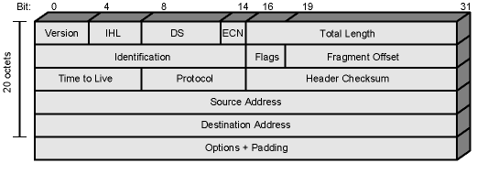
IP (Internet Protocol)
The core of the TCP/IP protocol suite
Two versions co-exist
v4 – the widely used IP protocol
v6 – has been standardized in 1996, but still not widely deployed
IP (v4) header minimum 20 octets (160 bits)

Slide 120
IPv6
IPv6
Enhancements over IPv4 for modern high speed networks
Support for multimedia data streams
But the driving force behind v6 was to increase address space
128-bit as compared to 32-bit of v4
Not backward compatible
all equipment and software must change

Slide 121
TCP
Transmission Control Protocol
end to end protocol
Reliable connection = provides flow and error control
In TCP terms, a connection is a
temporary association between entities in different systems
TCP PDU
Called “TCP segment”
Includes source and destination port
Identify respective users (applications)
pair of ports (together with the IP addresses) uniquely identify a connection; such an identification is necessary in order TCP to track segments between entities.

Slide 122
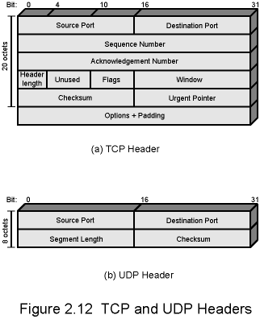
TCP Header

Slide 123
UDP
User Datagram Protocol
Alternative to TCP
end-to-end protocol
Not guaranteed delivery
No preservation of sequence
No protection against duplication
Minimum overhead

Slide 124
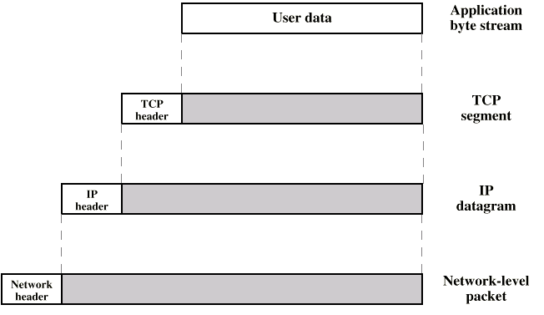
PDUs in TCP/IP
Dest. Port
Sequence number
Checksum
….
Dest. Address
Source address
….
Dest. Network Address
Priority info

Slide 125
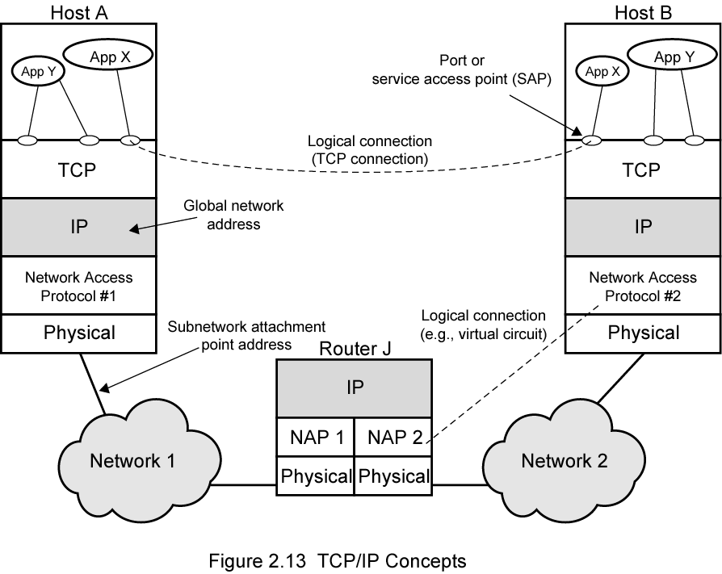
Operation of TCP and IP

Slide 126
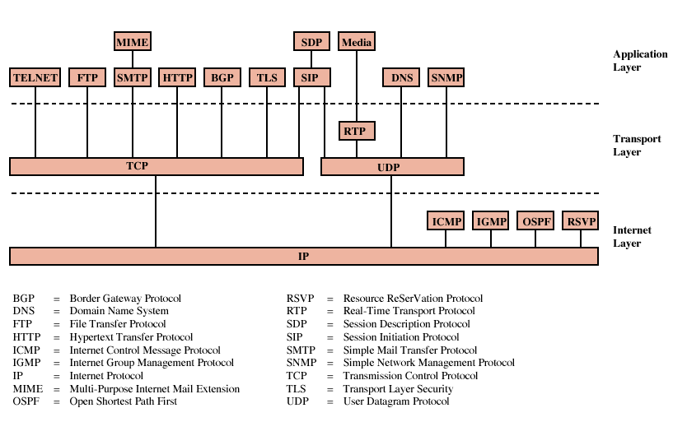
Some Protocols in TCP/IP Suite

Slide 127
TCP/IP
Transmission control Protocol/Internet Protocol
Developed by DARPA
No official protocol standard
Can identify five layers
Application
Host-to-Host (transport)
Internet
Network Access
Physical

Slide 128
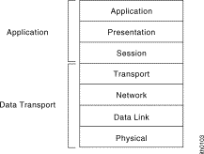
An OSI View of TCP/IP
Internet Model
OSI Model
F-D’s Model
Application
(http, telnet, snmp,
smtp, nfs, ftp)
Application
layer
Transport
(TCP, UDP)
Network
layer
Internet (IPv4/IPv6)
Network Access
(HDLC)
Data Link layer
Physical layer
Physical layer

Slide 129
Sender
Receiver
Application
Layer
Application
Layer
HTTP
Request
HTTP
Request
Transport
Layer
Transport
Layer
TCP
HTTP
Request
TCP
HTTP
Request
Network
Layer
Network
Layer
IP
TCP
HTTP
Request
IP
TCP
HTTP
Request
Data Link
Layer
Data Link
Layer
Ethernet
IP
TCP
HTTP
Request
Ethernet
IP
TCP
HTTP
Request
Physical
Layer
Physical
Layer

Slide 130
TCP/IP Network Access Layer
Exchange of data between end system and network
Address of host and destination
Prioritization of transmission
Software at this layer depends on network (e.g. X.25 vs. Ethernet)
Segregation means that no other software needs to be concerned about net specifics

Slide 131
TCP/IP Internet Layer
An Internet is an interconnection of two or more networks
Internet layer handles tasks similar to network access layer, but between networks rather than between nodes on a network
Uses IP for addressing and routing across networks
Implemented in workstations and routers

Slide 132
TCP/IP Transport Layer
Also called host-to-host layer
Reliable exchange of data between applications
Uses TCP protocols for transmission

Slide 133
TCP/IP Application Layer
Logic needed to support variety of applications
Separate module supports each type of application (e.g. file transfer)
FTP
HTTP
Telnet
News
SMTP

Slide 134
*TCP/IP
Application
Presentation
Session
TELNET FTP SMTP DNS SNMP DHCP
RIP
Transport
RTP
RTCP
Transmission
Control Protocol
User Datagram
Protocol
OSPF
IGMP
ICMP
Network
Internet Protocol
ARP
Data link
Physical
Ethernet
Token Bus
Token Ring
FDDI

Slide 135
TCP & UDP
Most TCP/IP applications use TCP for transport layer
TCP provides a connection (logical association) between two entities to regulate flow check errors
UDP (User Datagram Protocol) does not maintain a connection, and therefore does not guarantee delivery, preserve sequences, or protect against duplication

Slide 136
Internetworking
Interconnected networks, usually implies TCP/IP
Can appear to users as a single large network
The global Internet is the largest example, but intranets and extranets are also examples

Slide 137
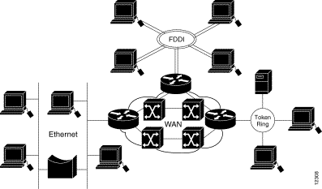
Internetworking

Slide 138
TCP Segment (TCP PDU)
Source port (16 bits)
Destination port (16 bits)
Sequence number (32 bits)
Acknowledgment number (32 bits)
Data Offset (4 bits)
Reserved (6 bits)
Flags (6 bits) : URG, ACK, PSH, RST, SYN, FIN
Window (16 bits)
Checksum (16 bits)
Urgent Pointer (16 bits)
Options (variable)
The size of TCP header is 192 bits = 24 byes.

Slide 139
IPv4 and IPv6
IP (IPv4) provides for 32-bit source and destination addresses, using a 192-bit header
IPv6 (1996 standard) provides for 128-bit addresses, using a 320-bit header.
Migration to IPv6 will be a very slow process

Slide 140
Why Need IPv6?
Internet Growth
Network numbers and size
Traffic management
Quality of Services (QoS)
Internet Transition
Routing
Addressing
No question that an IPv6 is needed, but when

Slide 141
IP Packet version
IP4
1
2
3
4
5
6
7
8
9
10
11
12
13
14
1 Version number 4 bits
2 Header length 4 bits
3 Type of Service 8 bits
4 Total length 16 bits
5 Identifiers 16 bits
6 Flags 3 bits
7 Packet offset 13 bits
8 Hop limit 8 bits
9 Protocol 8 bits
10 CRC 16 16 bits
11 Source address 32 bits
12 Destination Address 32 bits
13 Options varies
14 User data varies
15 Flow name 24 bits
16 Next header 8 bits
IP6
1
15
4
16
8
11 (128 bits)
12 (128 bits)
14

Slide 142
IPv4 Header
Version (4 bits)
Internet header length (4 bits)
Type of Service (8 bits)
Total Length (16 bits)
Identification (16 bits)
Flags (3 bits
Fragment Offset (13 bits)
Time to Live (8 bits)
Protocol (8 bits
Header Checksum (16 bits)
Source Address ( 32 bits)
Destination Address (32 bits)
Options (variable)
Padding (variable)

